Slide 1
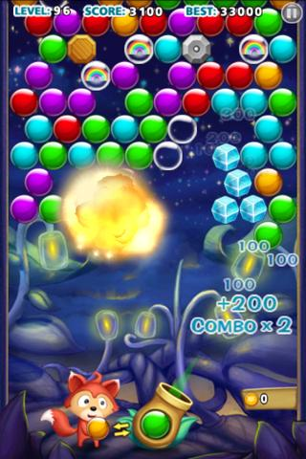
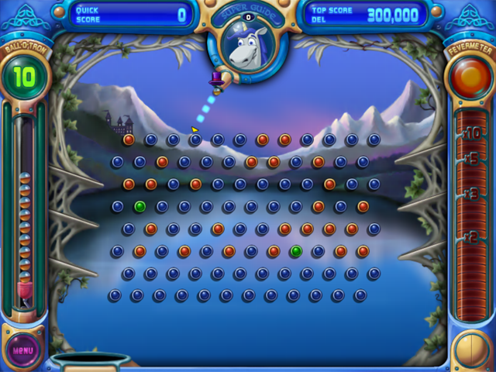
BouncE – A puzzle game

Slide 2
What is new
As many bounces as possible
Balls have abilities
Red – Slow momentum, increase gravity, random collision effect, generic negative effects
Blue – Lower gravity for 5 seconds
Purple star – manually reset the ball anywhere you want
Clear – the game pauses, change one attribute of your ball e.g. direction, velocity, size, shape for 5 seconds (if applicable)
Several other variations – see ball destination, score multiplier
User abilities – Can shuffle all the colours etc once every 15 seconds
Environmental objects – passing through certain areas may increase points, bonuses etc
Slower pace – forward planning

Slide 3
Rules
You only fire one ball
Once you hit the true bottom of the screen, play is over
Hitting 3 red balls in succession also causes the game to finish
Each time you hit a ball, it changes colour or disappears (5%)

Slide 4

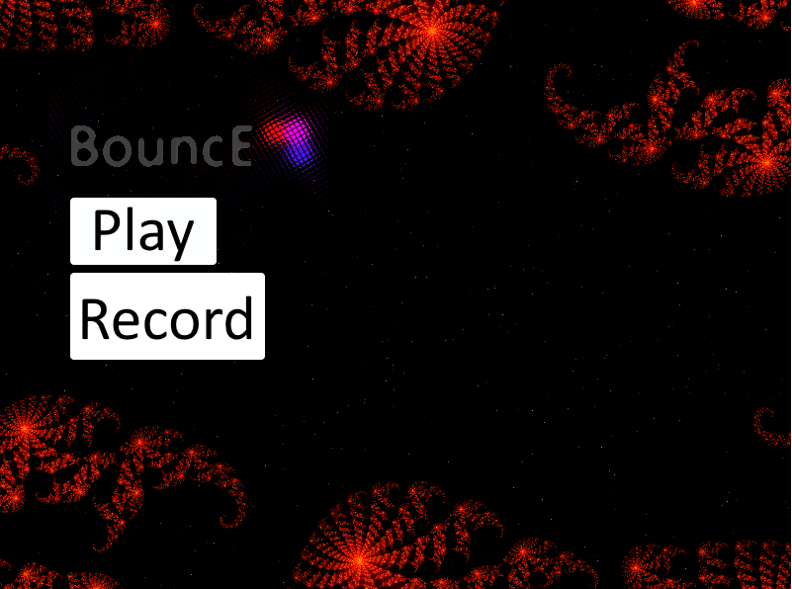
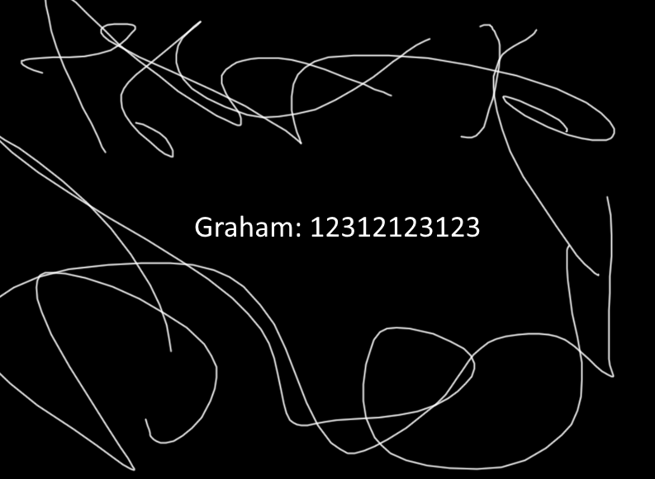
Init → Menu→ Score → Menu

Slide 5
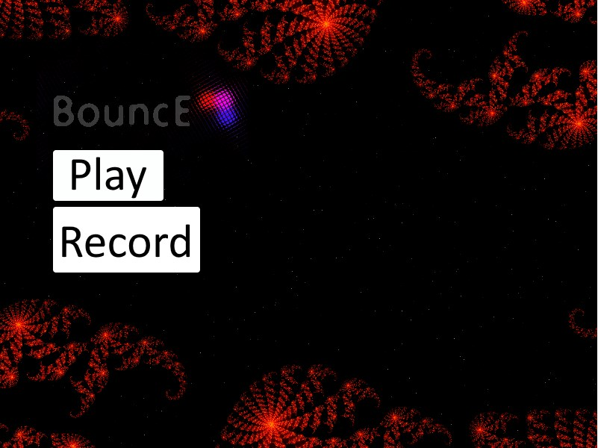
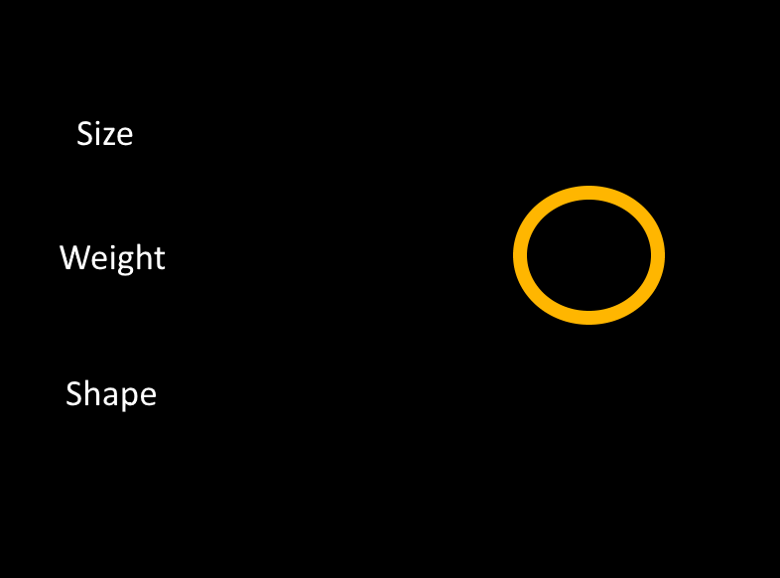
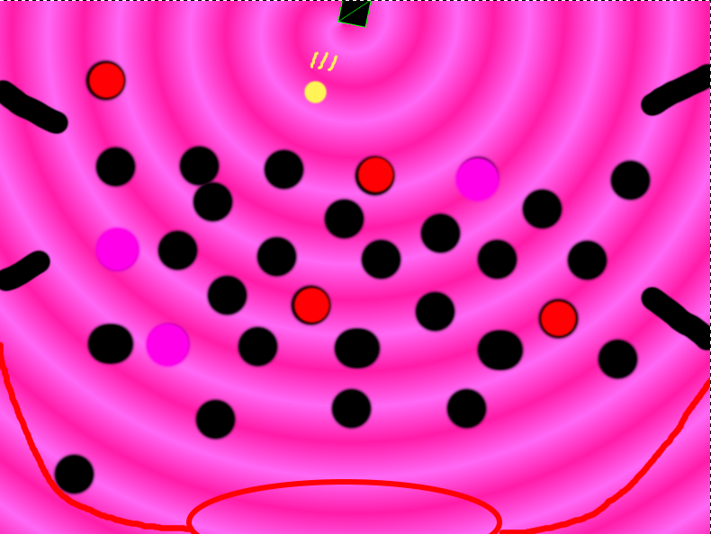
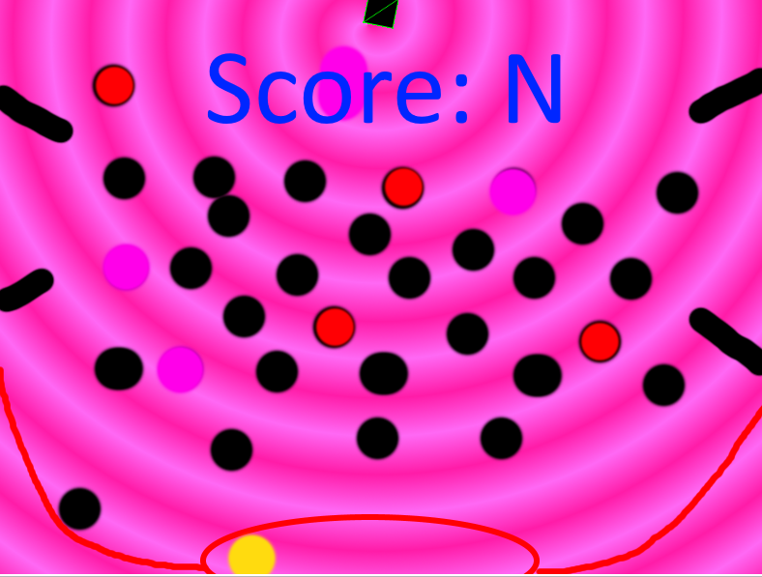
Init → Menu → Setup → Play → Score → Menu

Slide 6
Focus
Heavy focus on collision detection and physics
Many different combinations and outcomes on collision between the varying balls and environmental objects

